Slide 1
What do Field judges do?

Slide 3
Preparation
Field Ref'- duty sheet based on the timetable and number of officials
Equipment officer- prepare sign in sheets. May be visit stadium and check implements available there.
Technical Manager- inspect facilities, decide site layouts, prepare site diagrams
Ordinary officials - turn up in time for briefing

Slide 4
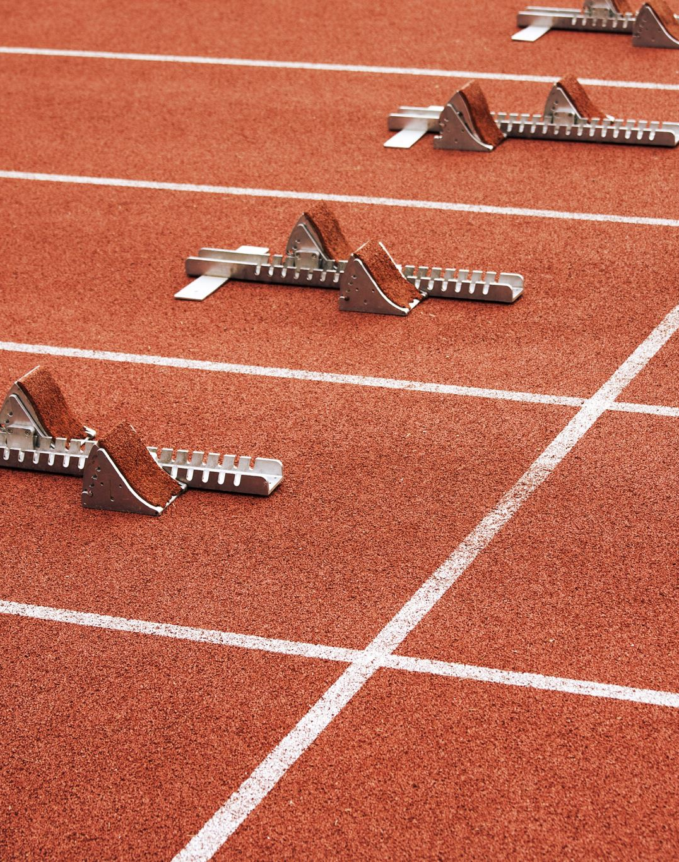
Clerk(s) of Course
Basically they are a part of the team that set up, ready the event sites, the track etc
They are the officials working with the TM to prepare sites for events and set out track hurdles, cones, etc
They also take out and return implements from the events and get them ready for the next.
Check the lists to see if all equipment is on site and in the right place.

Slide 5
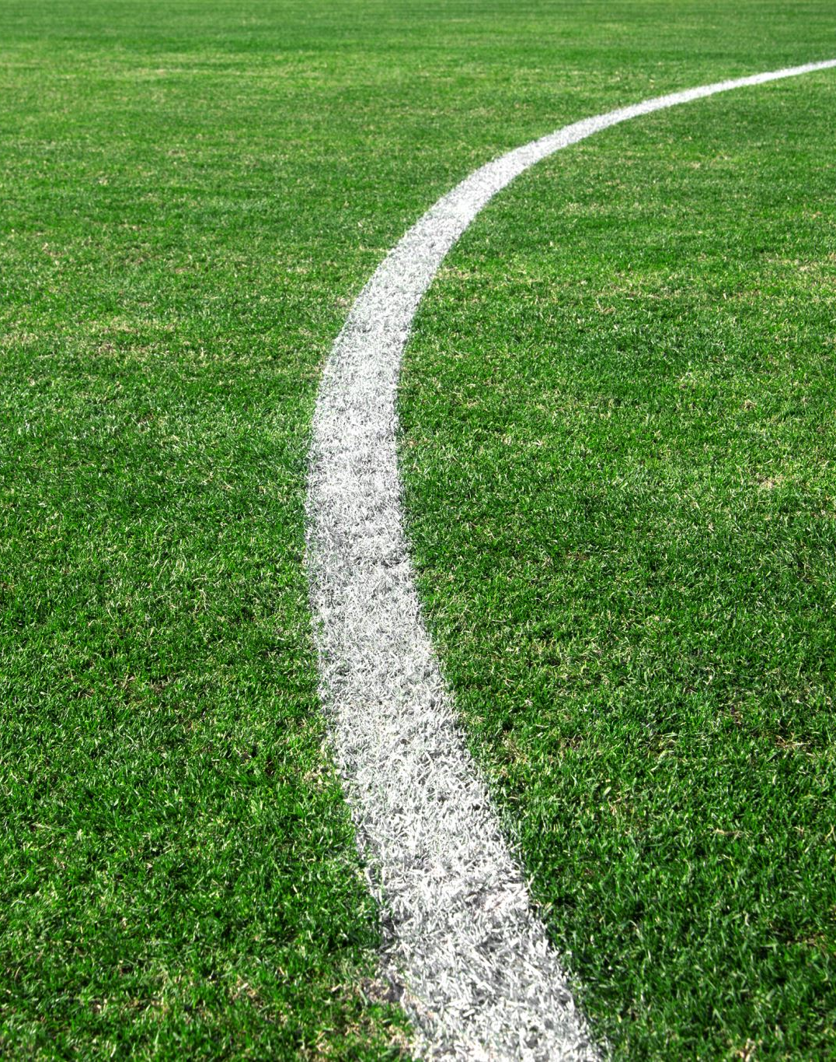
Check Lists & Stadiums
There are many different ones, and I acknowledge that I do appreciate the efforts that others have put in to produce them.
The level of preparedness of a stadium for competition can vary. Field judges do turn up and assist to get the sites ready.

Slide 6
Equipment we use
Clipboard(s) - wet or dry day?
Tape measures
Rakes to level the pit,
Warning horn
Spike
Rubber feet
8mm allen key and spirit level
Roller, & profile of no-jump indicator
Take off board lifters
Wind gauges
Clocks- analogue and digital

Slide 7
Equipment we are using at some of the events
EDM measurer linked to scoreboards
Tablet/laptop for results
Take off board cameras
Laptops- linked to electronic scoreboards
Electronic time clocks and wind gauge

Slide 8
At the start
Meet and greet the athletes & confirm number of jumps, & if left-handed
We register the athletes- the card may be filled in or we write their names etc
Allow them to work out their runway start position.
Give out markers/tape to help them mark their start position
Check numbers and spikes on registration
Warm up time allowed 30 mins for most, 45 for HJ, 60mins for PV.

Slide 9
Before the competition
Allow practice run throughs- 2 practice attempts in some events and in competition order. HJ & PV are slightly different.
PV & HJ attempts are allowed at different heights, and at different upright positions- & with a bungee for PV
UKA rules allow the foot position on the LJ/TJ to be shown at the board
Check that all officials are comfortable with their roles- amend roles.

Slide 10
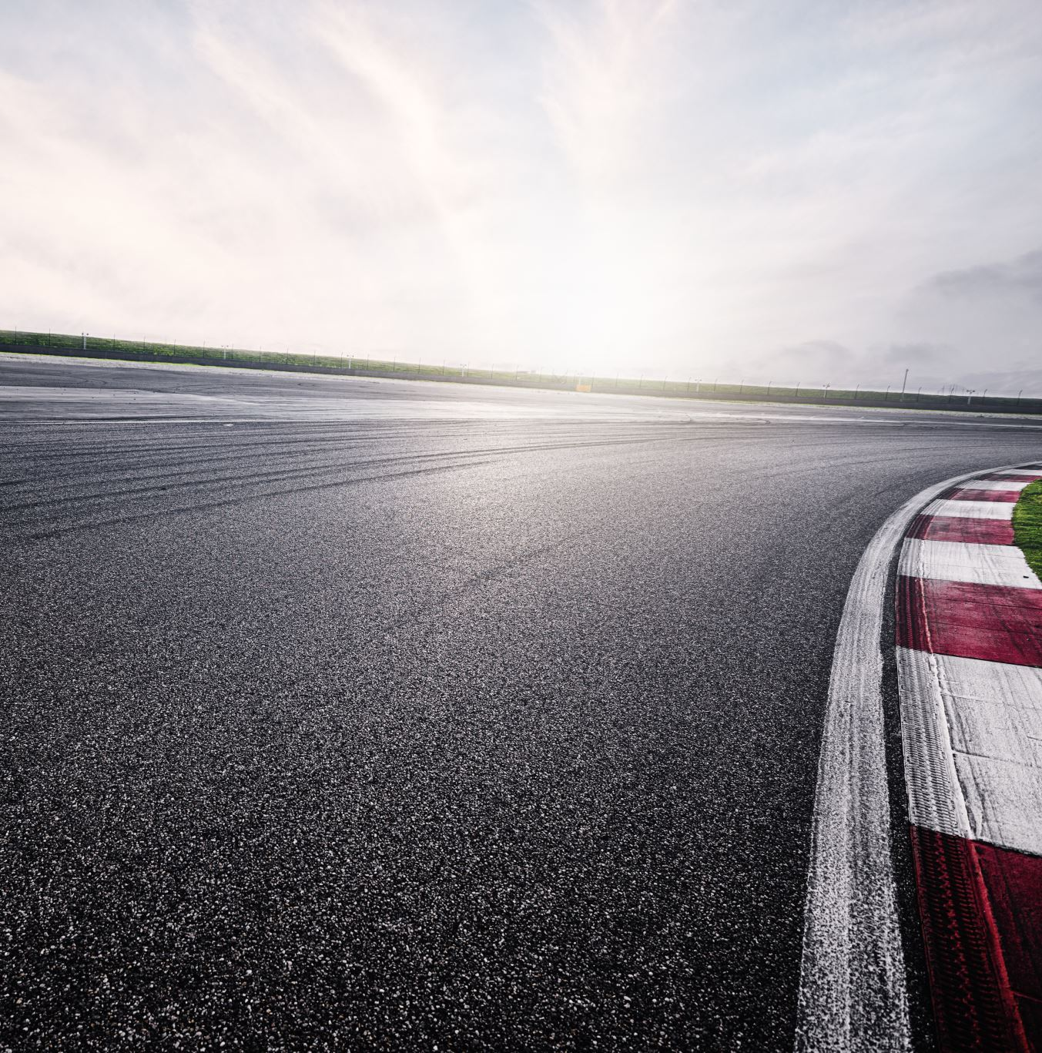
Before the competition
In the pit the sand will be levelled during warm up to ensure safety of the athletes.
Warm up will be supervised at the athlete's end and at the pit end and a cone placed on the runway to stop athletes when the pit is levelled etc

Slide 11
During competition in LJ/TJ
Call up athletes, -next is XXX, followed by XXX, and XXX to get ready- we tend to use Christian names
Athletes stand on the runway and when the pit end is ready the cone is lifted.
The time is started when the cone is lifted, yellow flag is lifted when 15 sec's remain) You can be timed out.
The wind gauge is started when they start to run (5secs)

Slide 12
During competition in LJ/TJ
We watch the athlete's foot on the board to see if it is valid jump
When the athlete leaves the pit a white flag is raised if a valid jump
Next the spiker will place the spike where the nearest mark to the take off board has been made in the sand
Rakers also judge the exit from the pit
The cone is placed on the runway

Slide 13
LJ/TJ continued
The tape is pulled parallel to the runway
The wind gauge reading is recorded by call up
The distance is read from the tape
Distance is recorded- on Card 1 and Card 2.
The pit is levelled, ready for the next jumper
AND so the cycle continues..... until all jumps are done
A protest may be made, so every jump may be needed to be measured and recorded on the card

Slide 14
Quick, accurate decisions are made

Slide 15
Hammer/ Discus/ Javelin- the long throws
We also have a set sequence of actions to perform
We register them Numbers, shoes/spikes, check gloves in hammer
Cone in centre of the gates for the cage, on runway near arc in Jav'.
Warm up throws- 2 in competition order
Check arm action of javelin throwers
Blow warning horn to gain attention and that all respond in the field

Slide 16
Hammer/ Discus/ Javelin- the long throws continued
Only allow athlete into cage after all have responded- retrievers, spiker, validity, photographers, starters etc
Call up to move to their position at the circle.
Tell them they are now allowed to throw.
Clock now starts when cone is lifted
Watch for foot infringements, check if landed in sector or hit the cage/gates and infringed the rules
Adjust the gates for left handed throwers in Hammer and reset after

Slide 17
Hammer/ Discus/ Javelin- the long throws
Spiker marks the landing place
Place cone on the runway or in cage opening
Don't step into the circle
Tape pulled through the centre of circle in a straight line or through 8m mark on the jav' runway.
Measure to the inside of the circle or inside of the arc and record distance.
Clear the tape away and exit cage

Slide 18
HJ & PV
As all of the other events we go through the process of welcoming and encouraging warm up.
These events differ, because we will need to know their starting height and in PV upright positions
HJ number of marks on the fan is 2 max, as in runway competitions
PV once the uprights, bar etc are in place as per the settings given to the leader beforehand the cone is lifted and the clock starts.
But changes now wanted are done in the time for the vault.
Timings for HJ & PV change depending is consecutive jumps and how many remain in the competition.

Slide 19
Shot
The rules we apply in hammer/discus also apply to the shot -with a few adaptations.
We now watch the action of the arm.
The feet can now touch the stop board at the front of the circle, but not the top of it.
Tape is pulled through the centre of the circle in a straight line, measured and recorded.
Tape is kept untwisted (as much as possible)
Clear circle, tape out of the way and spiker moves to the side for the next attempt

Slide 20
Let’s not forget the IPC events
We adapt the events to suit the athletes
Tie down chairs in the circle events and the metal work needed.
Place talc on the runway to judge the take off place of the foot in the LJ.
Allow clapping to orientate the visually impaired athlete
Attempts are organised differently- all have 6 throws, after 3 attempts the athlete gets a one min’ rest. After the next 3 throws the longest throw/landing place is measured. Each landing is marked – and is a numbered spike to know which attempt was best.

Slide 21
Any Questions?????

